Slide 1
CGB1221 – DATABASE MANAGEMENT SYSTEMS
Department of Artificial Intelligence and Data Science
Academic Year: 2024 – 2025 (Even Semester)
Register Number : 2303811724322085
Name : Priyadharshini J
Year : II-Year
Semester : IV-Semester
Section : B
Date : 04/06/2025

Slide 2
Title of the Project
FOOD ORDERING SYSTEM

Slide 3
Problem Identification
Traditional food ordering systems require physical presence or phone calls.
Manual order taking can lead to errors, delays, and inefficiency.
Lack of centralized order and user management causes confusion in busy restaurants.
No easy way for customers to browse menus, make payments, or track their orders online.
No admin dashboard for restaurant managers to view reports or manage items/users.

Slide 4
Objective
The objective is to build an online food ordering system that allows customers to browse menus, place orders, and make payments easily, while enabling admins to manage users, food items, and orders efficiently using a MySQL database.

Slide 5
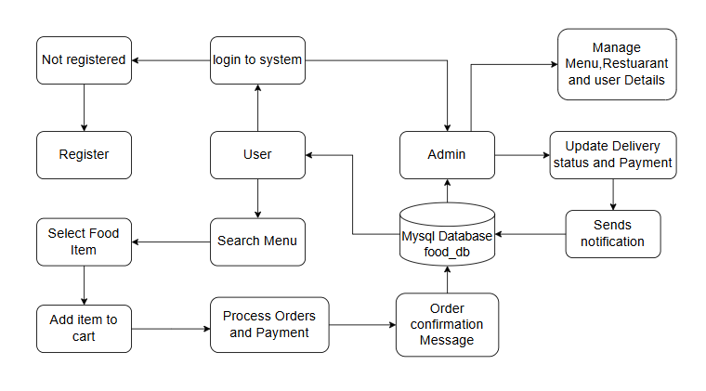
Proposed Architecture

Slide 6
Requirement Analysis
Hardware Requirements:
Processor: Intel i3 or higher
RAM: 4GB minimum
Storage: 1GB disk space
Software Requirements:
OS: Windows/Linux/Mac
XAMPP/WAMP (Apache, MySQL, PHP)
Browser (Chrome, Firefox)

Slide 7
Requirement Analysis
Functional Requirements
User registration and login/logout (Admin & Customer)
Browse menu and view food items
Place, confirm, and track orders
Online payment processing
Admin can manage menu items, users, and orders
View order history and payment status

Slide 8
Requirement Analysis
Non - Functional Requirements
User-friendly and responsive interface
Secure authentication and session management
Efficient and optimized database performance
Role-based access control (Admin & Customer)
Scalability to handle multiple users simultaneously
Data validation and error handling

Slide 9
List of Modules
Database and Utility Setup
User Management
Menus and Navigation
Customer Operations
Admin Operations

Slide 10
Module Description
Module 1: Database and Utility Setup
This Module involves initializing the core database structure necessary to operate the system. It includes creating relational tables such as users, orders, menu_items, payments, and order_details to support customer and admin operations.

Slide 11
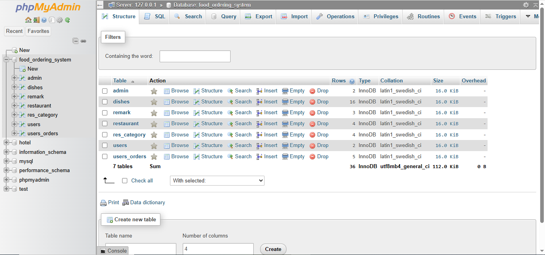
Module Implementation

Slide 12
Module Description
Module 2: User Management
This module handles the authentication system for both customers and admins. It provides secure login and registration functionalities using password hashing and role-based redirection, ensuring only authorized users can access specific features of the system.

Slide 13
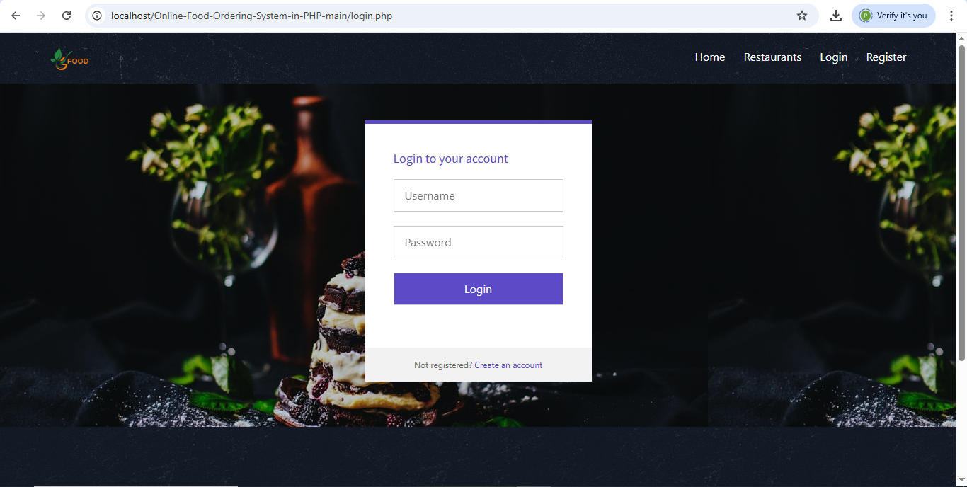
Module Implementation

Slide 14
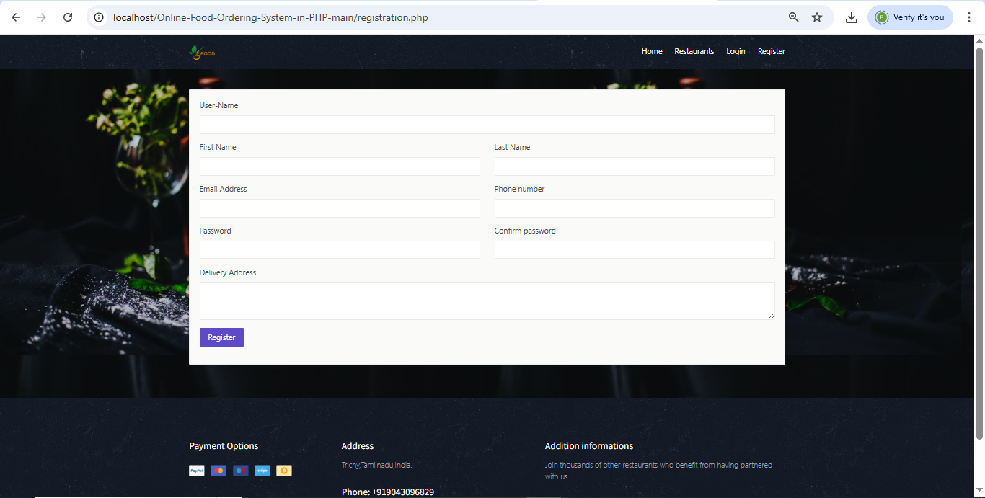
Module Implementation

Slide 15
Module Description
Module 3: Menus and Navigation
The menu module provides a categorized and searchable list of food items sourced from different restaurants. Customers can browse, filter, and select meals based on cuisine, price, or name, enhancing usability and the ordering experience.

Slide 16
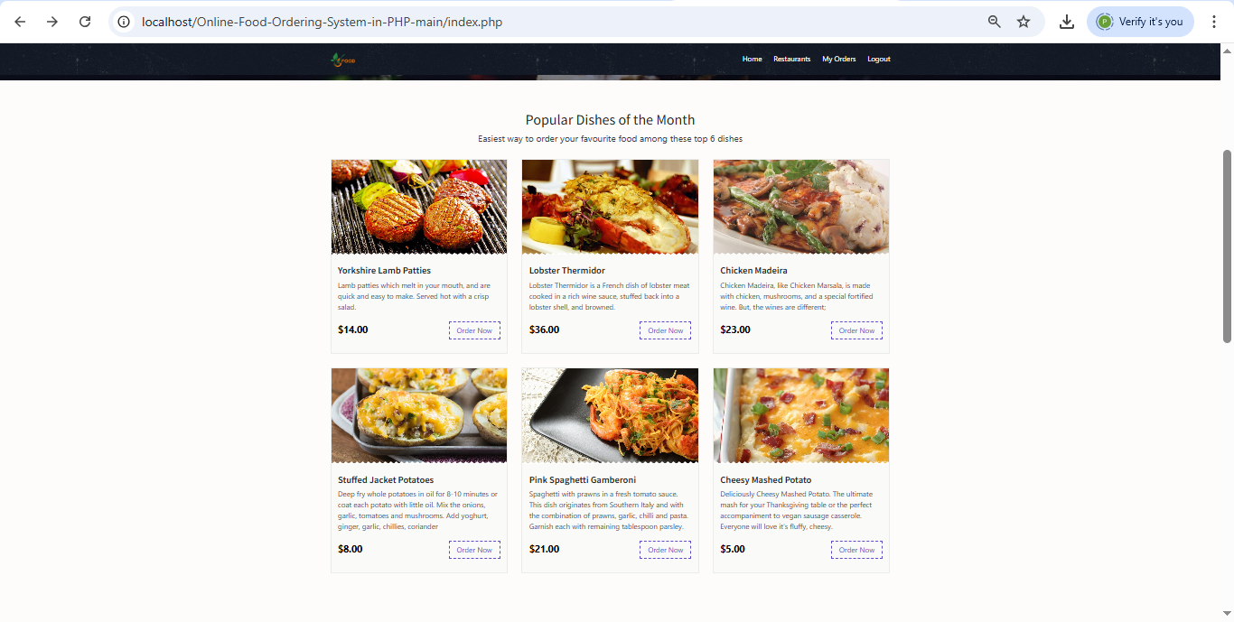
Module Implementation

Slide 17
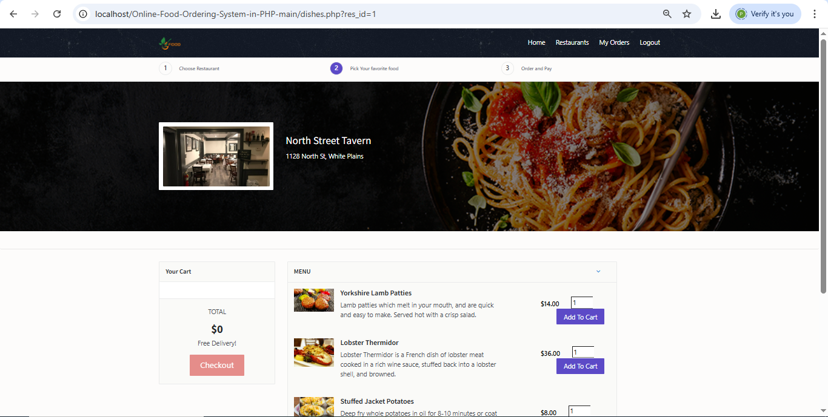
Module Implementation

Slide 18
Module Description
Module 4: Customer Operations
Customers can place new orders, track their status, and view previous order histories. The system also allows customers to complete payments online, check delivery updates, and receive order confirmation, providing a smooth end-to-end ordering process.

Slide 19
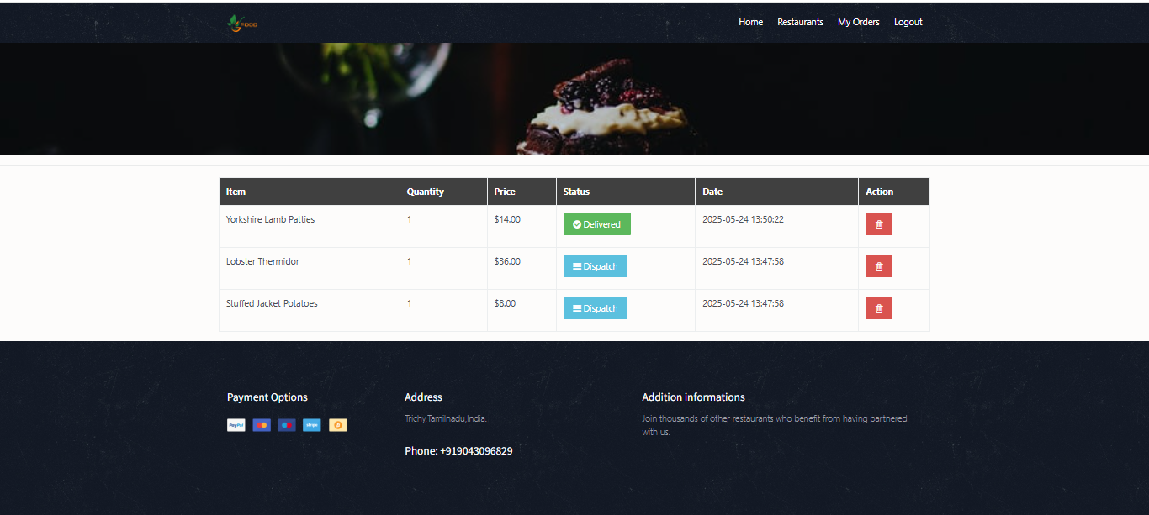
Module Implementation

Slide 20
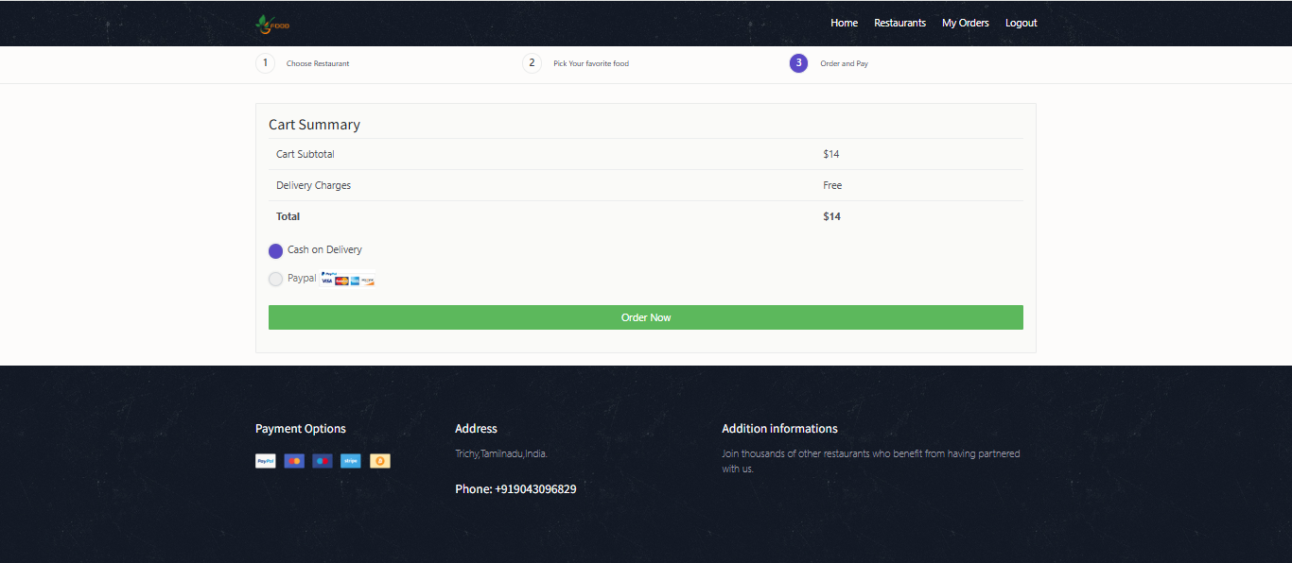
Module Implementation

Slide 21
Module Description
Module 5: Admin Operations
Admins have access to manage food items, view all customer orders, and maintain the overall user base. They can also generate reports, approve orders, and update the status of payments and deliveries, allowing them to monitor and control the system effectively.

Slide 22
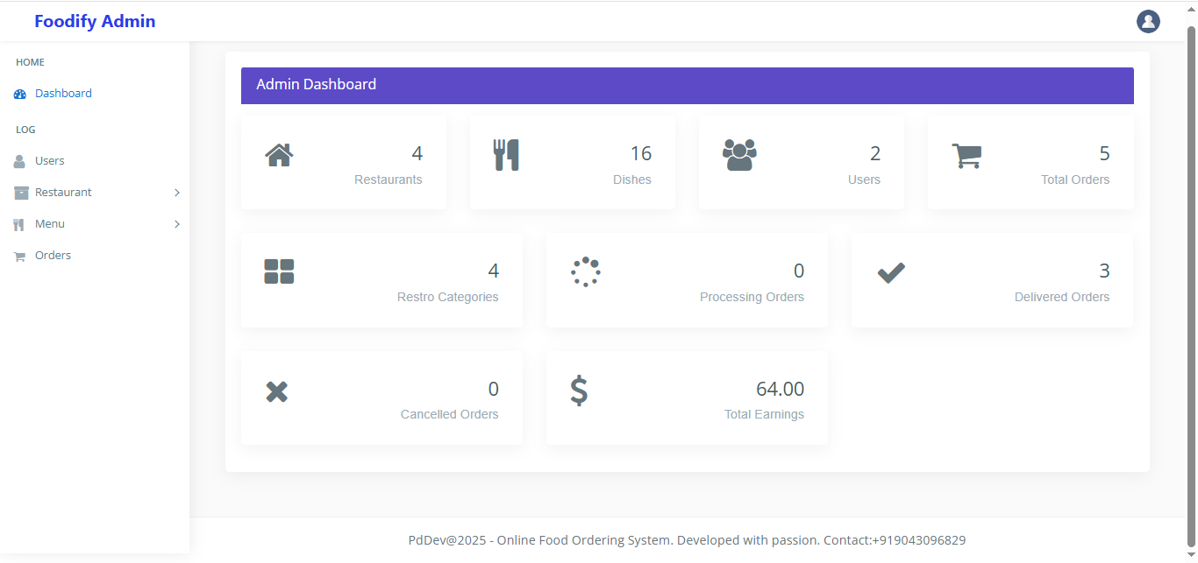
Module Implementation

Slide 23
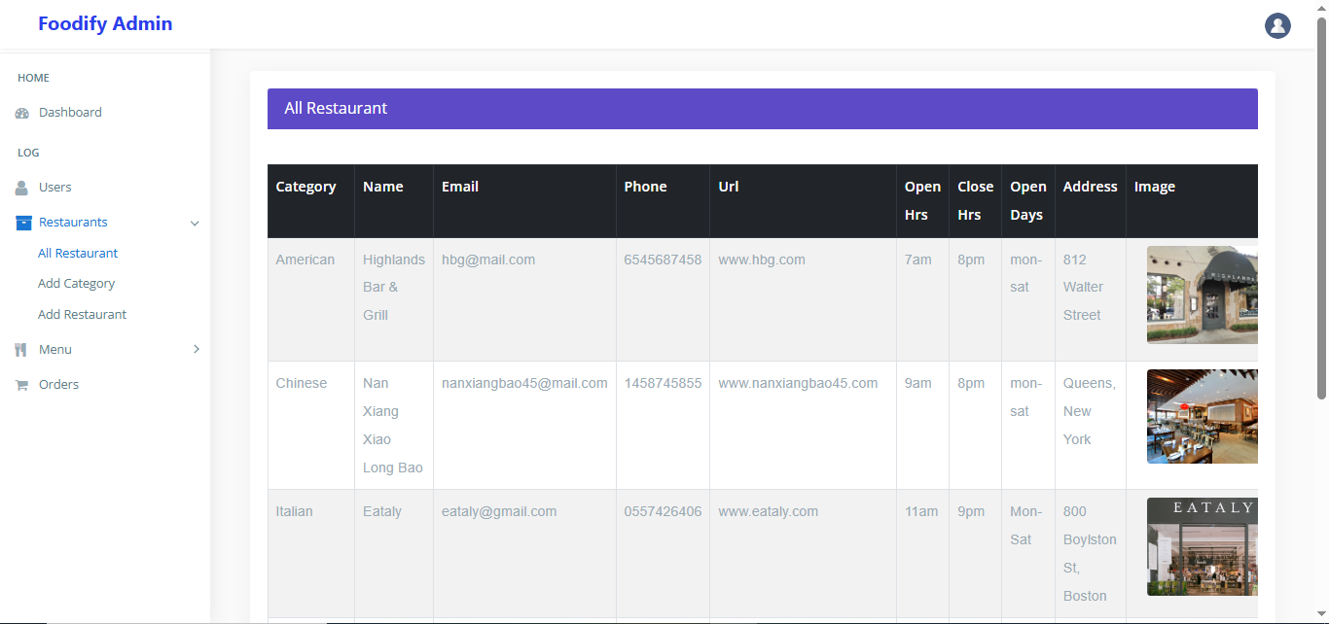
Module Implementation

Slide 24
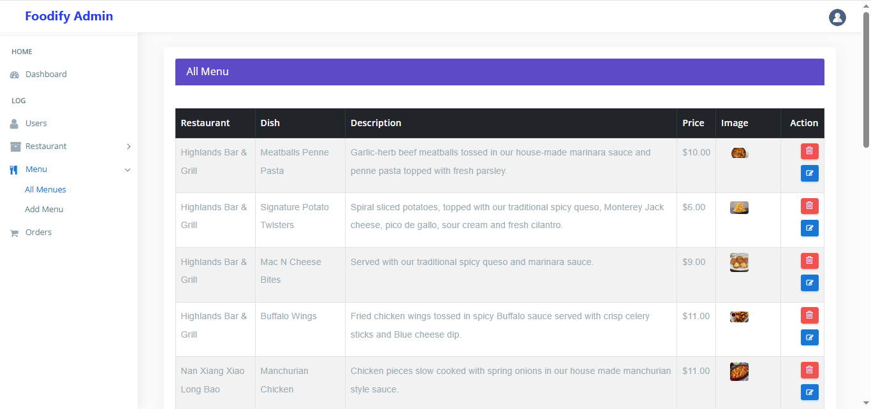
Module Implementation

Slide 25
Advantages of the system
Efficient relational schema ensures data consistency and scalability.
Role-based login with password hashing for customer and admin safety.
Simple navigation, searchable menus, and smooth ordering experience.
Admins can manage users, orders, payments, and menu items effectively.

Slide 26
Conclusion
This Online Food Ordering System offers a complete digital solution for food delivery services. Customers enjoy a smooth ordering experience while admins maintain full control of operations. Its modular code, secure login system, and well-structured database make it both practical and expandable for real-world use.

Slide 27
Thank You
Any queries???

